Slide 1
IBM Watson Data Expert Services Introduction & Context

Slide 2
Objectives of This Session
Upon completion of this module, you will:
Understand the business drivers for IBM Watson Data
Know the 7 steps to successful projects using IBM Watson Data
Have familiarity with the core capabilities of Watson Knowledge Catalog and Watson Studio
Be able to recognize valid IBM Watson Data use cases
IBM Watson AI / Watson & Cloud Platform Expert Services / © IBM Corporation
Notes:
Objectives for this session

Slide 3
IBM Watson Data Overview Watson Studio is an integrated platform of tools, services and data that help companies accelerate their shift to become data-driven organizations. Data Science is a team sport and Watson Studio was built as a collaborative platform for a community.
Why use IBM Watson Data
Personas that engage with IBM Watson Data
Solution Development Method Approach (CRISP-DM)
IBM Watson AI / Watson & Cloud Platform Expert Services / © IBM Corporation
Notes:
First we will do an overview of IBM Watson Data and what it is comprised of, some possible use cases, and then a brief demo to get familiar with the environment.

Slide 4
Why are enterprises struggling to capture the value of AI?
Data
Data resides in silos & difficult to access
Unstructured and external data wasn’t considered
Governance
If the data isn’t secure, self-service isn’t a reality
Challenge understanding data lineage and getting to a system of truth
Skills
Data Science skills are in low supply and high demand
Nurturing new data professionals is challenging
Tools & Infrastructure
Need an environment that enables a “fail fast” approach
Discrete tools present barriers to productivity
IBM Watson AI / Watson & Cloud Platform Expert Services / © IBM Corporation

Slide 5





IBM Watson Data is an integrated platform of tools, services and data that helps companies accelerate their shift to become data-driven organizations
Drives governance policy effectiveness while tracking how data is used and its value to the company
Data Steward
Builds data pipelines that power dashboards and data platforms while ensuring high quality
Data Engineer
Prepares data to tease out the insights they’re looking for, without IT involvement
Data Scientist
Business Analyst
Works with data to apply insights to the business strategy
App Developer
Makes insights immediately actionable and adds intelligence to apps in straightforward manner
IBM Watson AI / Watson & Cloud Platform Expert Services / © IBM Corporation
Notes:
Watson data platform is THE IBM public cloud foundation designed to support the data and analytics vision of whole enterprises
Delivering a fully integrated platform that sustains both analytical investigations and putting insights into active use in production at any scale.
It delivers the user experiences that amplify the ability of every data professional to execute on that vision

Slide 6

Making data into insights is a team sport
Data steward
Data scientist
Data engineer
Business Analyst
Developer
Find
Share
Collaborate
Our Core Tenets
Collaborative for data Professionals
Self-service access to trusted data
Best in class streaming and real-time analytics
Open and Extensible
Intelligent by Design
Projects | Data | Assets | Pipelines | APIs
Analyze
Ingest
Deploy
Persist
Intelligent governance | Policy enforcement
IBM Watson AI / Watson & Cloud Platform Expert Services / © IBM Corporation
Notes:
The most visible part of the platform is the persona driven experiences for data professionals as well as the collaboration capabilities that make them truly productive as a team.
The ability not just to find insights but to put them to use and keep them fresh by learning as new data comes in and collaborating with their peers during the process.
The platform isn’t only user experiences. developers and data scientists especially will rely on coding to get the most out of the assets they work with and deliver.
The integrated platform and its API delivers a real engine for data innovation through the experiences we deliver, our partners extend and customers innovate on.
The platform that enables you to:
Connect to data of any kind, stored or streaming, cloud and onprem, human created or IOT generated
Visualize prepare and cleanse that data for use
Persist it in the most appropriate and cost effective scalable data stores (Object, noSQL, warehouse or transactional db) and catalog it for everyone to find and use
Analyzing it in depth using projects, notebooks, machine learning models and more
Deploy the insights as compelling visualizations you can make decisions on, or baking them into existing or new applications, processes and more
Surrounding and supporting all these activities is non-intrusive intelligent active governance allowing you to manage risk without slowing down innovation

Slide 7
Solution Development Method Approach CRossIndustry Standard Process for Data Mining (CRISP-DM)
Seven steps to successful Data Mining
Define the business issue in a precise statement
Define the data model and data requirements
Source data from all available repositories
Evaluate the data quality
Select the mining algorithm or function to answer the business problem
Interpretation of the results and iterative cycles of improvement
Deploy the model into your business
Business Understanding
Data Understanding
Data Preparation
Deployment
Data
Modeling
Evaluation
IBM Watson AI / Watson & Cloud Platform Expert Services / © IBM Corporation
Notes:
The method used most frequently by data scientists is CRISP-DM which is a data mining approach. A data scientist might do all of these steps manually in a notebook writing code in python. Operationalizing what the scientist build may drive additional processes in the standardization and model building for a production deployment
CRISP-DM - CRISP-DM, which stands for Cross-Industry Standard Process for Data Mining, is an industry-proven way to guide your data mining efforts.
SEMMA - The SAS Institute developed SEMMA as the process of data mining. It has five steps (Sample, Explore, Modify, Model, and Assess), earning the acronym of SEMMA.
KDD process - The term KDD stands for Knowledge Discovery in Databases. It refers to the broad procedure of discovering knowledge in data and emphasizes the high-level applications of specific Data Mining techniques
TDSP - The Team Data Science Process (TDSP) is an agile, iterative data science methodology to deliver predictive analytics solutions and intelligent applications efficiently.
Scrum - The scrum analysis is the technique of data mining which is applied to predict the consequences according to the data.
Kanban
Domain-specific methodology
Data Mining Techniques
1. Tracking patterns. One of the most basic techniques in data mining is learning to recognize patterns in your data sets. This is usually a recognition of some aberration in your data happening at regular intervals, or an ebb and flow of a certain variable over time. For example, you might see that your sales of a certain product seem to spike just before the holidays, or notice that warmer weather drives more people to your website.
2. Classification. Classification is a more complex data mining technique that forces you to collect various attributes together into discernable categories, which you can then use to draw further conclusions, or serve some function. For example, if you’re evaluating data on individual customers’ financial backgrounds and purchase histories, you might be able to classify them as “low,” “medium,” or “high” credit risks. You could then use these classifications to learn even more about those customers.
3. Association. Association is related to tracking patterns, but is more specific to dependently linked variables. In this case, you’ll look for specific events or attributes that are highly correlated with another event or attribute; for example, you might notice that when your customers buy a specific item, they also often buy a second, related item. This is usually what’s used to populate “people also bought” sections of online stores.
4. Outlier detection. In many cases, simply recognizing the overarching pattern can’t give you a clear understanding of your data set. You also need to be able to identify anomalies, or outliers in your data. For example, if your purchasers are almost exclusively male, but during one strange week in July, there’s a huge spike in female purchasers, you’ll want to investigate the spike and see what drove it, so you can either replicate it or better understand your audience in the process.
5. Clustering. Clustering is very similar to classification, but involves grouping chunks of data together based on their similarities. For example, you might choose to cluster different demographics of your audience into different packets based on how much disposable income they have, or how often they tend to shop at your store.
6. Regression. Regression, used primarily as a form of planning and modeling, is used to identify the likelihood of a certain variable, given the presence of other variables. For example, you could use it to project a certain price, based on other factors like availability, consumer demand, and competition. More specifically, regression’s main focus is to help you uncover the exact relationship between two (or more) variables in a given data set.
7. Prediction. Prediction is one of the most valuable data mining techniques, since it’s used to project the types of data you’ll see in the future. In many cases, just recognizing and understanding historical trends is enough to chart a somewhat accurate prediction of what will happen in the future. For example, you might review consumers’ credit histories and past purchases to predict whether they’ll be a credit risk in the future.

Slide 8
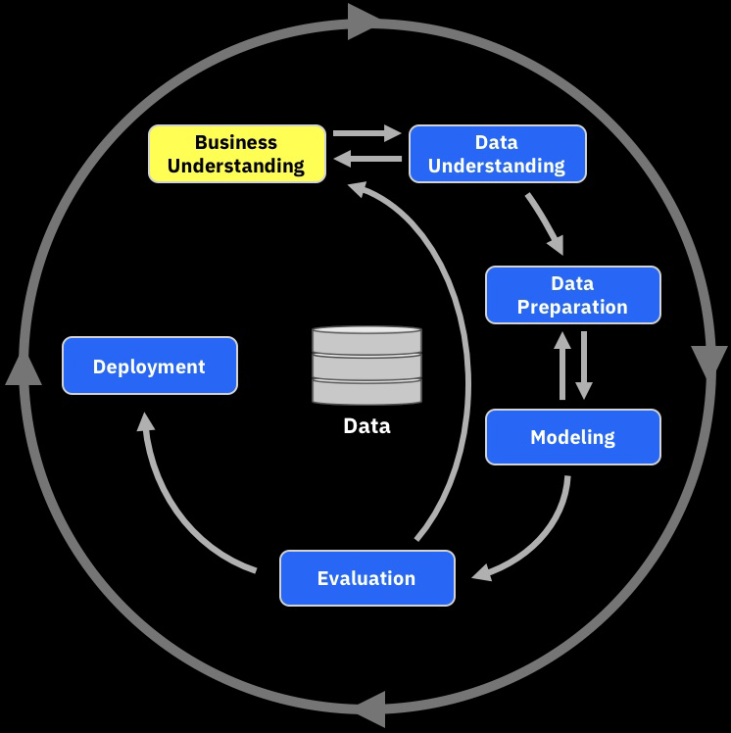
Business Understanding
Step 1 – Define the business issue in a precise statement
Identify the business issue that you want to address and then determine how the business issue can be translated into a question, or set of questions, that data mining can address.
By business issue we mean that there is an identified problem to which you need an answer, where you suspect, or know, that the answer is buried somewhere in the data, but you are not sure where it is.
“How can I get better targeting and success in customer retention?”
VP of Marketing
Business Analyst
IBM Watson AI / Watson & Cloud Platform Expert Services / © IBM Corporation
Notes:
A business issue should fulfil the requirements of having:
A clear description of the problem to be addressed
An understanding of the data that might be relevant – is the data sufficient to answer the business problem?
A vision for how you are going to use the model in your business – This can often guide the analysis
usage – considers the ownership and who has access

Slide 9
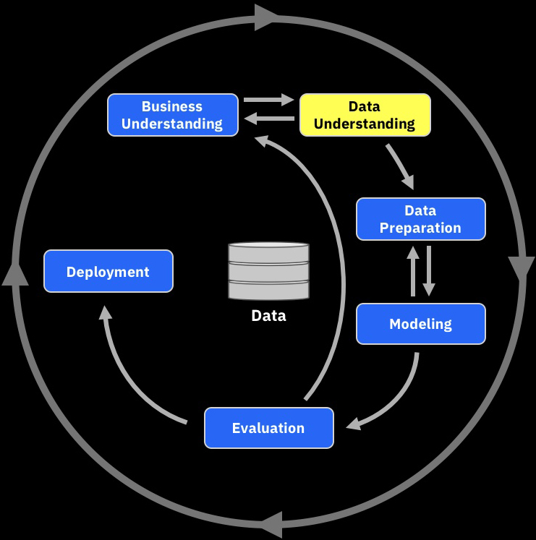
Data Understanding and Preparation
Step 2 – Define the data model and data requirements
Typically, the data model will define:
Data sources used – Physical location
Data types – How the data is structured
Data content – Lists the data files, tables and fields
Data Description – delivers the name and description of these fields
Data usage – considers the ownership and who has access
Catalog
Data
IBM Watson AI / Watson & Cloud Platform Expert Services / © IBM Corporation

Slide 10
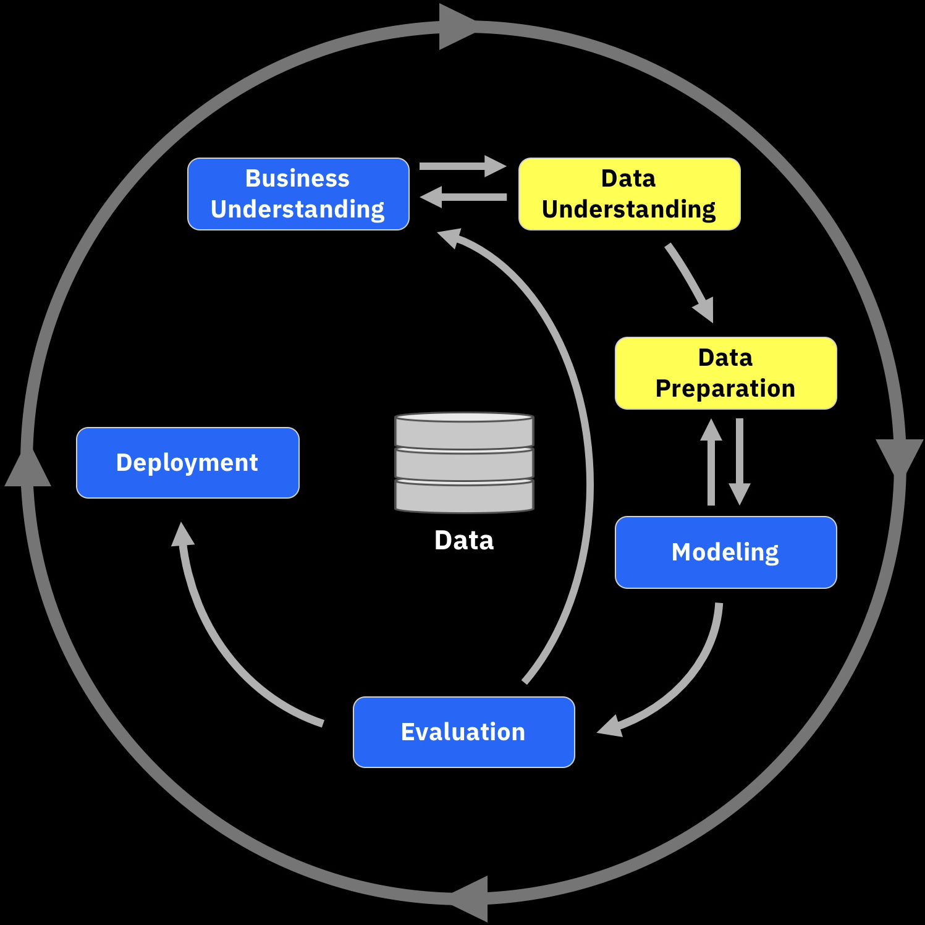
Data Understanding and Preparation
Step 3 –Source data from all available repositories
Sourcing and preprocessing of the data that populates the data model. This includes identifying, collecting, filtering and aggregating of raw data into a format required by the data models and selected mining algorithm.
Data preparation is often the most time consuming part of the data mining methodology
Content Manager
Data Sources
Select
De-normalised Data
Cleanse
Filter
Aggregate
IBM Watson AI / Watson & Cloud Platform Expert Services / © IBM Corporation

Slide 11
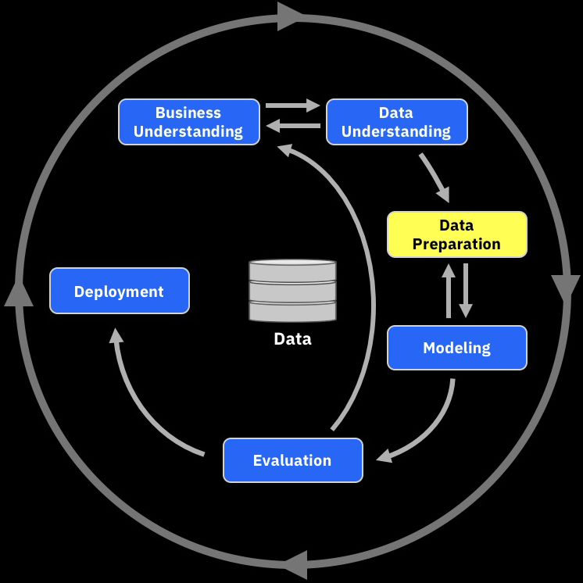
Data Understanding and Preparation
Step 4 – Evaluate the data quality
Having populated the data model the next step is to ensure that the data fulfils the requirement of completeness, exactness and relevance
Validity of chosen variables – perform univariate statistical analysis to visually inspect the maximum, minimum, mean and standard deviation values for each variable to detect implausible distributions – e.g. a negative age
Handling of outliers and missing values – Outliers and missing values can produce biased results. The mitigation of outliers and the transformation of missing data into meaningful information can improve data quality enormously.
Variable Selection – Variables can be superfluous by presenting the same or very similar information as others. Dependent or highly correlated variables can be found by performing statistical tests like bivariate statistics, linear and polynomial regression. Dependent variables should be reduced by selecting one variable for all others or by composing a new variable for all correlated ones by factor or component analysis. Variable reduction will improve model performance
Validity of chosen variables – Visual Inspection
Handling of outliers and missing values
Variable selection – removal of redundant variables
IBM Watson AI / Watson & Cloud Platform Expert Services / © IBM Corporation
Notes:
Validity of chosen variables – perform univariate statistical analysis to visually inspect the maximum, minimum, mean and standard deviation values for each variable to detect implausible distributions – e.g. a negative age
Handling of outliers and missing values – Outliers and missing values can produce biased results. The mitigation of outliers and the transformation of missing data into meaningful information can improve data quality enormously.
Variable Selection – Variables can be superfluous by presenting the same or very similar information as others. Dependent or highly correlated variables can be found by performing statistical tests like bivariate statistics, linear and polynomial regression. Dependent variables should be reduced by selecting one variable for all others or by composing a new variable for all correlated ones by factor or component analysis. Variable reduction will improve model performance

Slide 12
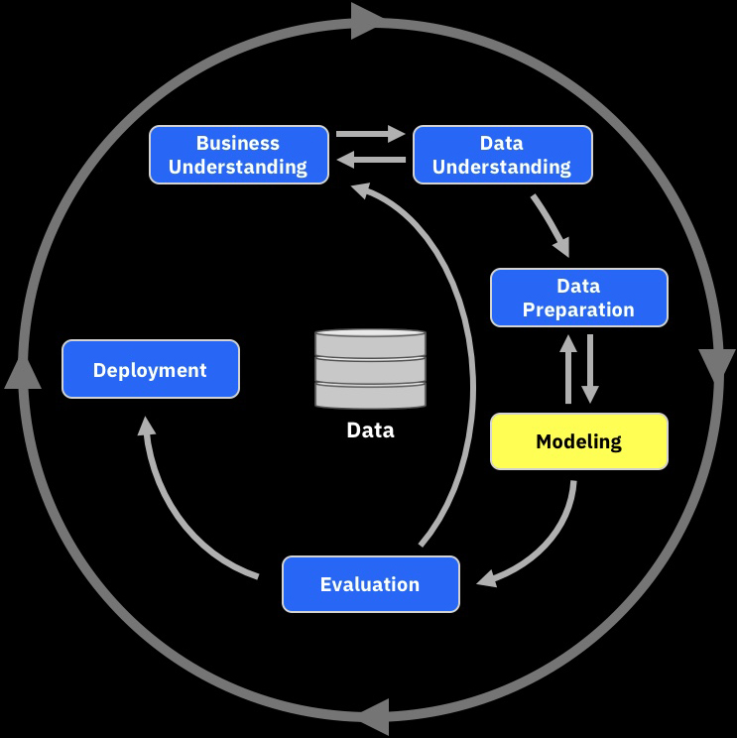
Modeling
Step 5 – Select the mining algorithm or function to answer the business problem
Selection of the best suited modeling techniques to use for a given business problem.
Some standard techniques:
Classification
Associations
Clustering
Prediction
Similar patterns
Similar time sequences
The selection of the method will normally be obvious, for example, market basket analysis in retail will use associations technique which was originally developed for this purpose.
IBM Watson AI / Watson & Cloud Platform Expert Services / © IBM Corporation
Notes:
This steps not only includes defining the appropriate technique or mix of techniques to use, but also the way in which the techniques should be applied
The Challenge is usually not which technique to use, but the way in which the technique should be applied. All the techniques will require some form of parameter selection which requires experience of how the techniques work and what the various parameters do.

Slide 13
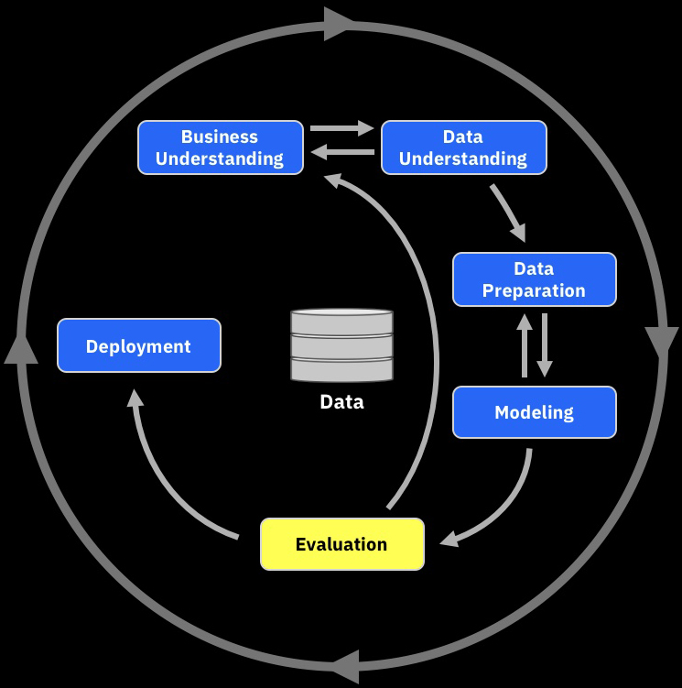
Evaluation
Step 6 – Interpretation of the results and iterative cycles of improvement
The results from performing any type of data modeling can provide a wealth of information that can sometimes be difficult to interpret.
Experience says that the interpretation phase requires the input from a business expert who can translate the results back into the business context.
There are a number of statistical and visualization tools available that can assist the interpretation process
Provide Data or Visualization
VP of Marketing
Data Scientist
IBM Watson AI / Watson & Cloud Platform Expert Services / © IBM Corporation

Slide 14
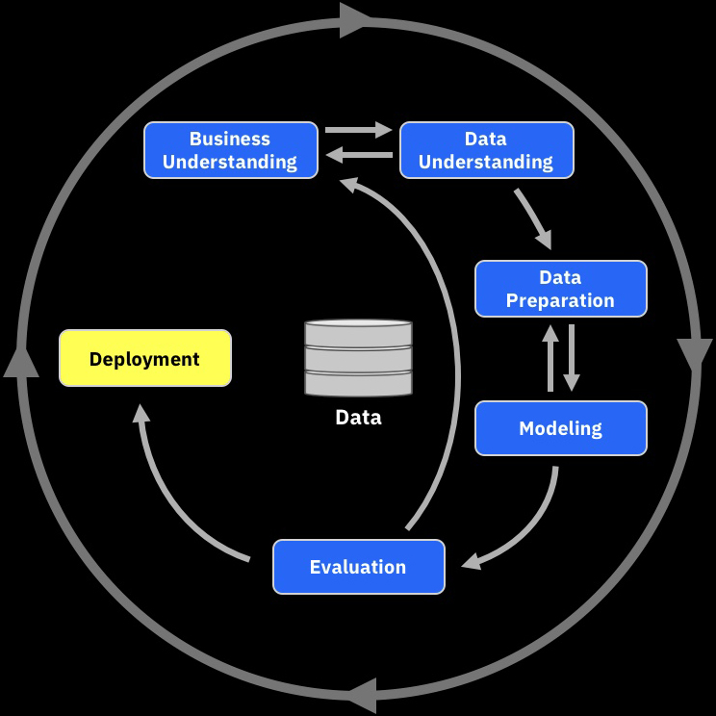
Deployment
Step 7 – Deploy the model into your business
Watson Studio is more than just an analytical tool and to realize the full potential it is important to understand how to use the model and where in your business the results will have the greatest impact
Models
Streaming
Transactional
Batch
IBM Watson AI / Watson & Cloud Platform Expert Services / © IBM Corporation

Slide 15
CRISP-DM Mapped to Watson Studio and the Knowledge Catalog
Business Understanding
Data Understanding
BUSINESS GLOSSARY
KNOWLEDGE CATALOG
Data Preparation
DATA REFINERY
Deployment
WML, NOTEBOOKS
Data
Modeling
Data
NOTEBOOKS, SPSS, MODELS
Evaluation
SPSS, WML, STREAMING
IBM Watson AI / Watson & Cloud Platform Expert Services / © IBM Corporation
Notes:
The method used most frequently by data scientists is CRISP-DM which is a data mining approach. A data scientist might do all of these steps manually in a notebook writing code in python. Operationalizing what the scientist build may drive additional processes in the standardization and model building for a production deployment

Slide 16
Sample business problem: Churn Analysis
“What are our retention and churn rates across products and geos?”
“How can I get better targeting and success in customer retention?”
Visualize &
Explore Insights
Business Analyst
Fetch Data
VP of Marketing
Curate
“Can we refine our customer segmentation model and develop more refined propensity models?”
Data
Data Steward
Data Engineer
Provide Data or Visualization
Rapid data evaluation and extraction of necessary attributes to support analysis
Discovery through shop for data
Rapid hypothesis testing
Iterative analysis and model building through discovery and collaboration
Deploy scoring models into existing campaign management processes
Fetch Data
Conform
Data
“What data attributes are in the available sets of data which can be used ?”
Data Scientist
Visualize &
Explore Insights
Build Models
Notes:
This is an example of a business problem that is directly associated with churn analysis. It starts with a request from the business, the VP of Marketing, presents a business problem to the business analyst. The Marketing question is “How can I get better targeting and success in customer retention?”. In the case of a mobile telephone service provider, churn is defined as how frequently a customer discontinues their service to move to a competitor. This is frequently referred to as a retention issue, how do you retain the customer.
The business analyst starts to look at the question and wants to understand what the current churn rates are. To do this the business analyst can go out to the data catalog and “fetch” an existing file that the data steward has already curated. This file might contain customer churn data. The business analyst can explore the data and maybe build a report from it. In addition, the analyst might want to do some analytics on the dataset to understand what the key elements are that affect churn. However, for a much deeper understanding which a detailed model would provide, the business analyst would reach out to a data scientist who can analyze broader sets of data and attributes.

Slide 17
Sample Scenarios
IBM Watson AI / Watson & Cloud Platform Expert Services / © IBM Corporation

Slide 18
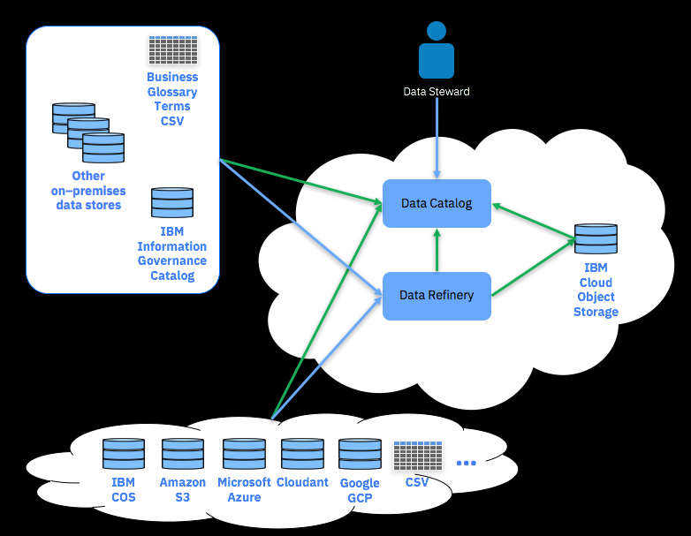
360-degree View of Data
Provide the ability to
Ingest metadata for data sources accessed via services, stored on the IBM Cloud, or data stores outside of the IBM Cloud
Classify and profile data
Develop security policies and rules for data access and protection
Monitor governance policy enforcements and activities
Ingest and define business terms and descriptions for common understanding
IBM Watson AI / Watson & Cloud Platform Expert Services / © IBM Corporation
Notes:
Here we are looking to get insight from our metadata. The Data Catalog is a metadata repository that can be used to record your cloud data, your on-premises data, your business definitions, etc. That allows you to see what data is available, where it resides, what business terminology you have and allows you to relate the technical and business data.
What type of use cases do you expect to see that WDP can help with?

Slide 19
AI and Machine Learning Integration Use Case Recommendation Engine Use Case
Provide the ability to
understand patterns in customer interactions,
provide a more personalized experience, and
build and implement models for recommendations
Flow
Develop and Analyze
Gather data sources and catalog them
Prepare for analysis
Develop predictive model and deploy
Operational
Application Orchestration/business process
Model scores Q&A
Next Best Action application leverages Model scores
IBM Watson AI / Watson & Cloud Platform Expert Services / © IBM Corporation
Notes:
We have combined the AI and Machine Learning Integration and Recommendation Engine Use Cases here as there is a lot of synergy between them. We will talk later to illustrate how all thiese pieces fit together to solve the business problem

Slide 20
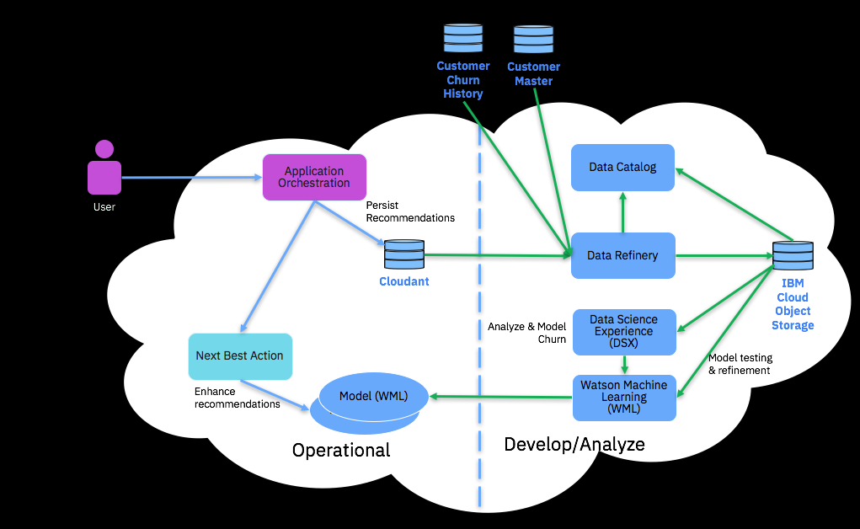
Customer Churn Analysis
Provide the ability to
Fine tune recommendation models to address customer retention and churn
Leverage data on-premises and on cloud
Build and implement models to understand and predict churn
Deploy models to support Next Best Action recommendations for churn
Flow
Develop and Analyze
Gather data sources and catalog them
Prepare for analysis
Develop predictive model and deploy
Operational
Application Orchestration/business process
Next Best Action Application scores using model
IBM Watson AI / Watson & Cloud Platform Expert Services / © IBM Corporation
Notes:
Here is an example of Churn analysis. We will be discussing this further as we progress through our 2 day learn session
Churn analysis is the evaluation of a company's customer loss rate in order to reduce it.
Also referred to as customer attrition rate, churn can be minimized by assessing your product and how people use it.

Slide 21
IBM Watson AI / Watson & Cloud Platform Expert Services / © IBM Corporation

Slide 22
Q&A
IBM Watson AI / Watson & Cloud Platform Expert Services / © IBM Corporation

Slide 23
BACKUP
IBM Watson AI / Watson & Cloud Platform Expert Services / © IBM Corporation

Slide 24
The IBM Watson is a platform for data
Self Service Experience
Watson Studio
Collaborative data science
Data Refinery
Data preparation & integration
Dashboards
Dashboarding & reporting
Watson Knowledge Catalog
Data & analytical asset organization
with governance
Data Movement and Processing
Analytics Engine
Hadoop & Spark
Watson Machine Learning
ML processing & management
Streaming Analytics
Analytics for data-in-motion
Message Hub
Kafka
Lift
Ground-to-cloud transfer
Data Persistence
IBM Cloud Object Storage
Cloudant
Compose
(Mongo, Janus Graph, Redis, Postgres, Elastic Search, ScyllaDB, MySQL, RabbitMQ, etcd, RethinkDB
Db2 Warehouse
on Cloud
Db2 on Cloud
IBM Cloud
SQL Query
Infrastructure
Availability Zones
Identity & Access Controls
Encryption Key Management
IBM Watson AI / Watson & Cloud Platform Expert Services / © IBM Corporation
Notes:
Watson Data Platform at its core is the Data Science Experience, the Data Refinery, the Data Catalog, and Dashboards (in Beta now).
Beyond that it is an ecosystem or portfolio of related services
IAE- IBM Analytics Engine provides a Spark which allows you to scale compute and storage independently. It leverages the IBM Cloud Object Storage as its long term persistent data store
WML Watson Machine Learning -
Streaming Analytics -
Message Hub which is a Kafka based messaging bus
Lift – which is a subset of the IBM Aspera capabilities that allow you to do bulk data transfer from on-premises to the IBM Cloud
IBM Cloudant is a NoSQL JSON document store that’s optimized for handling heavy workloads of concurrent reads and writes in the cloud
Compose, or more correctly, Compose Enterprise, is a managed offering providing 10 open source Cloud databases
Db2 Warehouse on Cloud is a relational database offering optimized for warehouse style access and throughput
Db2 on Cloud is a traditional relational database offering that is optimized for transactional processing
IBM Cloud SQL Query is a new capability that supports using SQL to access a number of different relational and non-relational data stores
This is all built on top of the IBM Cloud Infrastructure capabilities including, but not limited to,
Availability Zones which provide inter-datacenter high availability within a region,
Identity and Access Controls which controls access to resources and services in the IBM Cloud and can be integrated with your on-premises LDAP allowing you to control access to your environment
Encryption Key Management to ensure that your data is secure and protected

